Slide 1
Introduction
to
PHP

Slide 2
Introduction to PHP
“PHP is a server-side scripting language designed specifically for the Web. Within an HTML page, you can embed PHP code that will be executed each time the page is visited. Your PHP code is interpreted at the Web server and generates HTML or other output that the visitor will see” (“PHP and MySQL Web Development”, Luke Welling and Laura Thomson, SAMS)

Slide 3
URLs and web servers
http://server/path/file
usually when you type a URL in your browser:
your computer looks up the server's IP address using DNS
your browser connects to that IP address and requests the given file
the web server software (e.g. Apache) grabs that file from the server's local file system, and sends back its contents to you
some URLs actually specify programs that the web server should run, and then send their output back to you as the result:
https://csjmu.ac.in/quote.php
the above URL tells the server csjmu.ac.in to run the program quote.php and send back its output

Slide 4




Server-Side web programming
server-side pages are programs written using one of many web programming languages/frameworks
examples: PHP, Java/JSP, Ruby on Rails, ASP.NET, Python, Perl
the web server contains software that allows it to run those programs and send back their output
each language/framework has its pros and cons
we will use PHP for server-side programming

Slide 5
PHP History
1994: Created by Rasmis Lesdorf, software engineer (part of Apache Team)
1995: Called Personal Home Page Tool, then released as version 2 with name PHP/FI (Form Interpreter, to analyze SQL queries)
Half 1997: used by 50,000 web sites
October 1998: used by 100,000 websites
End 1999: used by 1,000,000 websites

Slide 6
Good about PHP
Open-source
Easy to use ( C-like and Perl-like syntax)
Stable and fast
Multiplatform
Many databases support
Many common built-in libraries
Pre-installed in Linux distributions

Slide 7
Why PHP?
There are many other options for server-side languages: Ruby on Rails, JSP, ASP.NET, etc. Why choose PHP?
free and open source: anyone can run a PHP-enabled server free of charge
compatible: supported by most popular web servers
simple: lots of built-in functionality; familiar syntax
available: installed on servers and most commercial web hosts
well-documented: type php.net/functionName in browser Address bar to get docs for any function

Slide 8
What is PHP?
PHP stands for "PHP Hypertext Preprocessor"
a server-side scripting language
used to make web pages dynamic:
provide different content depending on context
interface with other services: database, e-mail, etc
authenticate users
process form information
PHP code can be embedded in HTML code

Slide 9
What is PHP (cont’d)
Interpreted language, scripts are parsed at run-time rather than compiled beforehand
Executed on the server-side
Source-code not visible by client
‘View Source’ in browsers does not display the PHP code
Various built-in functions allow for fast development
Compatible with many popular databases

Slide 10
What does PHP code look like?
Structurally similar to C/C++
Supports procedural and object-oriented paradigm (to some degree)
All PHP statements end with a semi-colon
Each PHP script must be enclosed in the reserved PHP tag
<?php
… ?>

Slide 11
How PHP generates HTML/JS Web pages
Client Browser
1
4
3
PHP module
Apache
2
1: Client from browser send HTTP request (with POST/GET variables)
2: Apache recognizes that a PHP script is requested and sends the request to PHP module
3: PHP interpreter executes PHP script, collects script output and sends it back
4: Apache replies to client using the PHP script output as HTML output

Slide 12
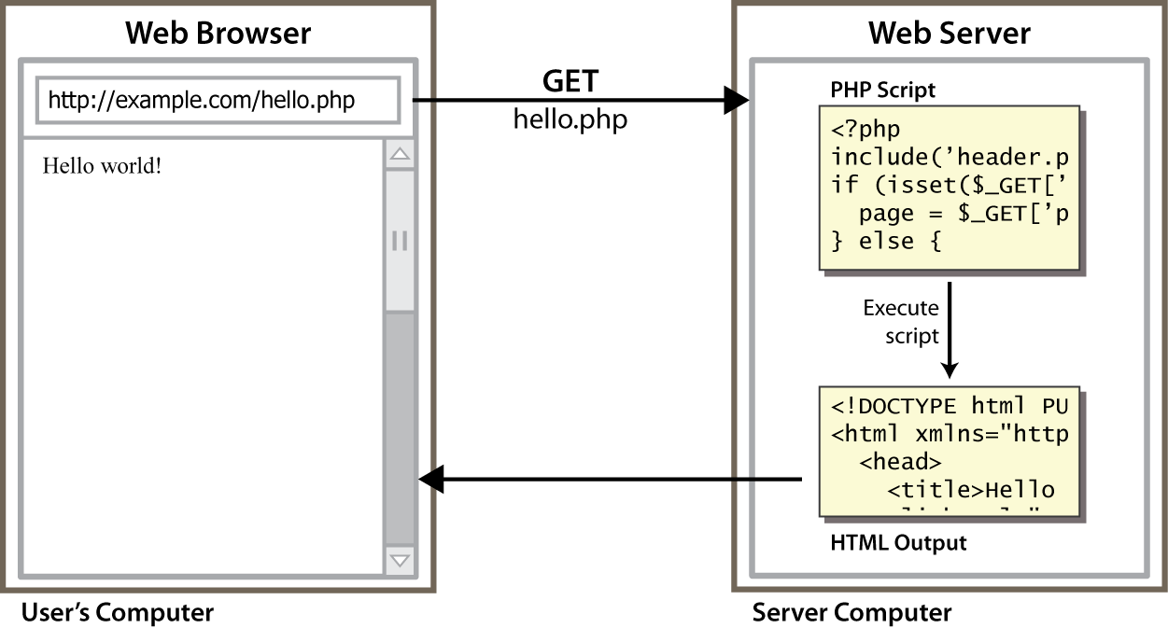
Lifecycle of a PHP web request
browser requests a .html file (static content): server just sends that file
browser requests a .php file (dynamic content): server reads it, runs any script code inside it, then

Slide 13
Hello, World!
The following contents could go into a file hello.php:
<?php
print "Hello, world!";
?> PHP
Hello, world! output
a block or file of PHP code begins with <?php and ends with ?>
PHP statements, function declarations, etc. appear between these endpoints

Slide 14
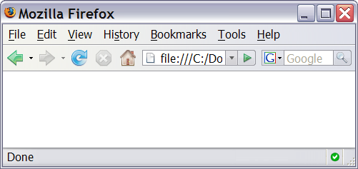
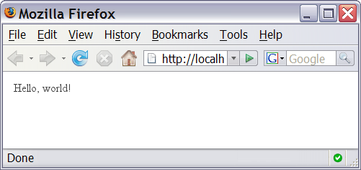
Viewing PHP output
you can't view your .php page on your local hard drive; you'll either see nothing or see the PHP source code
if you upload the file to a PHP-enabled web server, requesting the .php file will run the program and send you back its output

Slide 15
Console output: print
print "text"; PHP
print "Hello, World!\n";
print "Escape \"chars\" are the SAME as in Java!\n";
print "You can have
line breaks in a string.";
print 'A string can use "single-quotes". It\'s cool!'; PHP
Hello, World! Escape "chars" are the SAME as in Java! You can have line breaks in a string. A string can use "single-quotes". It's cool! output
some PHP programmers use the equivalent echo instead of print

